Slide 1

Capturing Emerging Complexity in Lenia

Slide 2
Contents
Motivation and Open Endedness
Lenia
Evolving complex behavior
  Genetic Operators
  Evolutionary Lenia
Results and Conclusions

Slide 3
Part 1: Lenia

Slide 4
Motivation and Open Endedness
Motivation to choose this research
  Deepen our knowledge in Evolution and Alife
  Biology, Computer Science and AI
Why Open Endedness matters
  open-endedness allows AI systems to continue to learn and improve over time, adapting to changing environments and evolving to meet new challenges
Research Question
  Understanding of Evolution and Complexity
  How GA can evolve complex behavior in Lenia
Notes:
Motivation: Complex systems and emerging phenomena. The objective is to deepen our understanding of artificial life and evolution, which has implications for fields such as biology, computer science, and artificial intelligence.
Why open Endedness matters? Open-endedness is important in AI because it enables the development of more flexible, creative, and autonomous systems that can solve a wider range of problems and tasks. It also facilitates the emergence of unexpected and potentially useful behaviors or solutions that may not have been anticipated by human designers. In addition, open-endedness allows AI systems to continue to learn and improve over time, adapting to changing environments and evolving to meet new challenges. Open-ended systems can continuously evolve and adapt, leading to the emergence of increasingly complex and intelligent behaviors. Understanding open-endedness is essential for advancing our understanding of AGI and its potential applications.
Research question: To what extent can Lenia, as an artificial life platform, contribute to our understanding of artificial life and evolution, and how can the Genetic Algorithm be utilized to evolve complex behaviors in Lenia

Slide 5
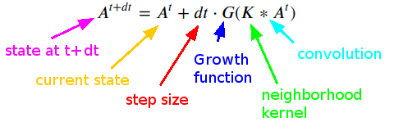
Lenia
Lenia update rule
GoL (Discrete) – (a)
Smoothed Kernel and Growth mapping function – (b)

Slide 6
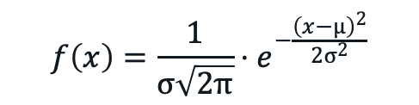
A small recap from Mathematics: Gaussian
Value of the
function at a
point x
$$f\left(x\right)=\frac{1}{σ\sqrt{2π}}⋅e^{−\frac{{\left(x−μ\right)}^{2}}{2σ^{2}}}$$

Slide 7
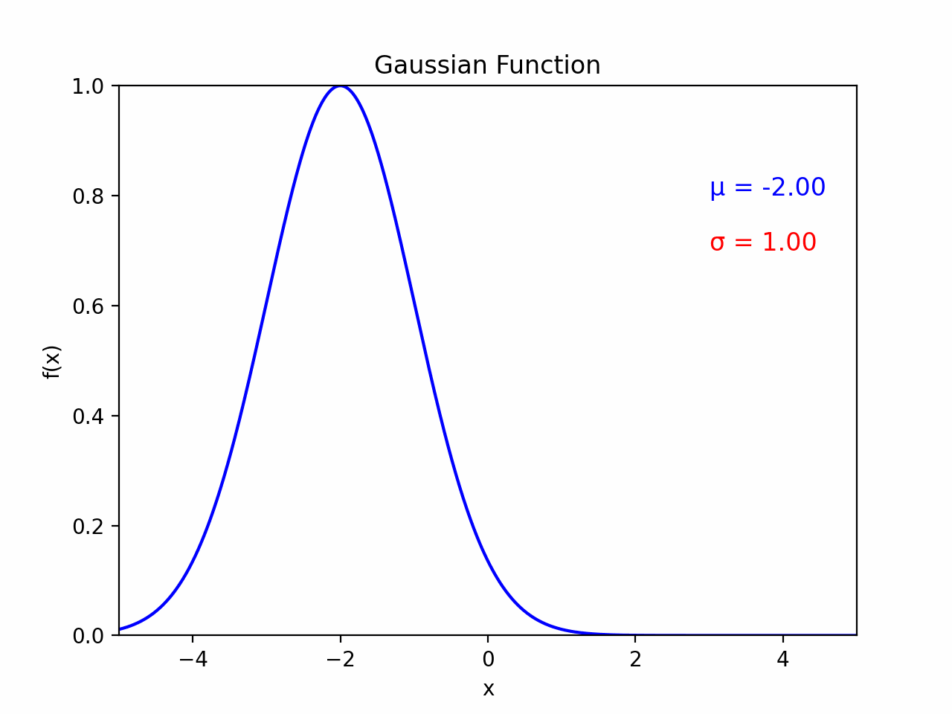
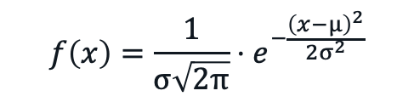
A small recap from Mathematics: Gaussian
μ: central value or peak (A most likely value in a distribution)
$$f\left(x\right)=\frac{1}{σ\sqrt{2π}}⋅e^{−\frac{{\left(x−μ\right)}^{2}}{2σ^{2}}}$$

Slide 8
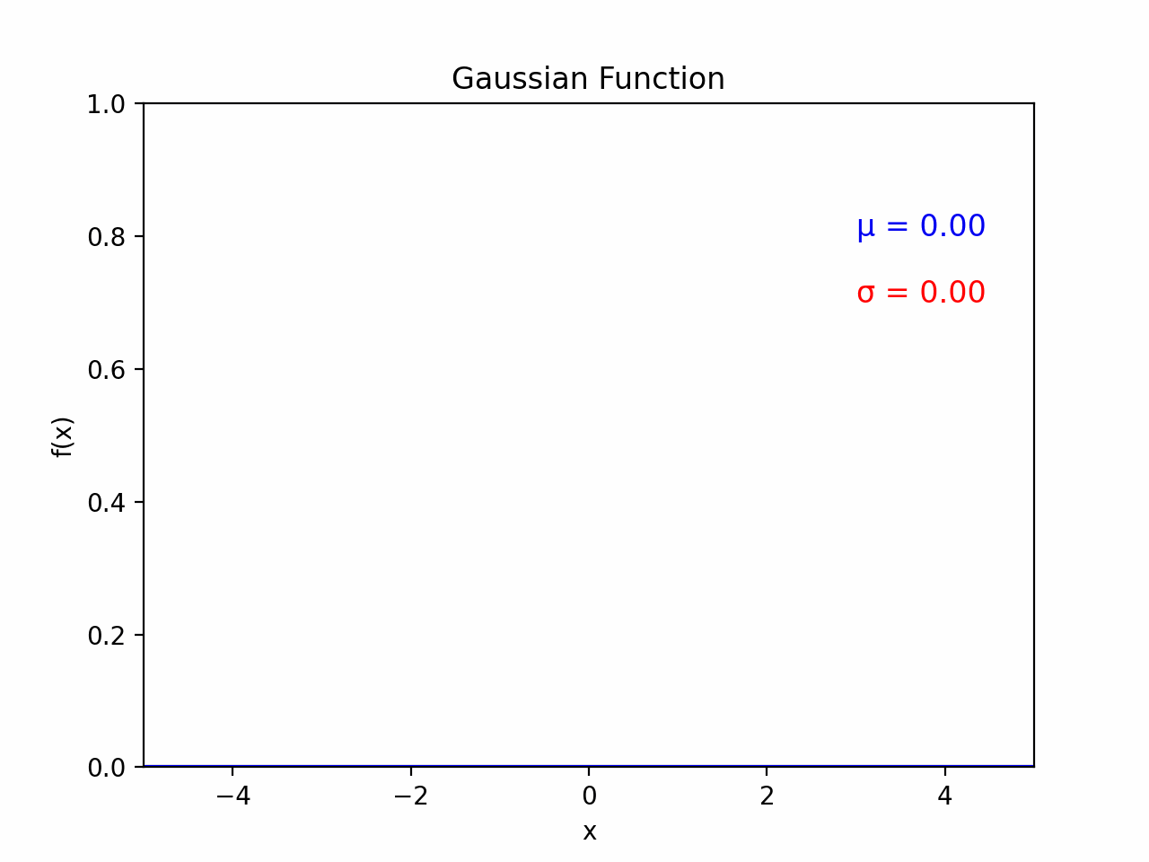

A small recap from Mathematics: Gaussian
$$f\left(x\right)=\frac{1}{σ\sqrt{2π}}⋅e^{−\frac{{\left(x−μ\right)}^{2}}{2σ^{2}}}$$
σ: std. determines the spread of the curve (with larger values of σ resulting in broader curves and smaller values leading to narrower curves)

Slide 9
A small recap from Mathematics: Gaussian
$$f\left(x\right)=\frac{1}{σ\sqrt{2π}}⋅e^{−\frac{{\left(x−μ\right)}^{2}}{2σ^{2}}}$$
Normalization, as AUC (probability value) value should stay between 0 and 1

Slide 10
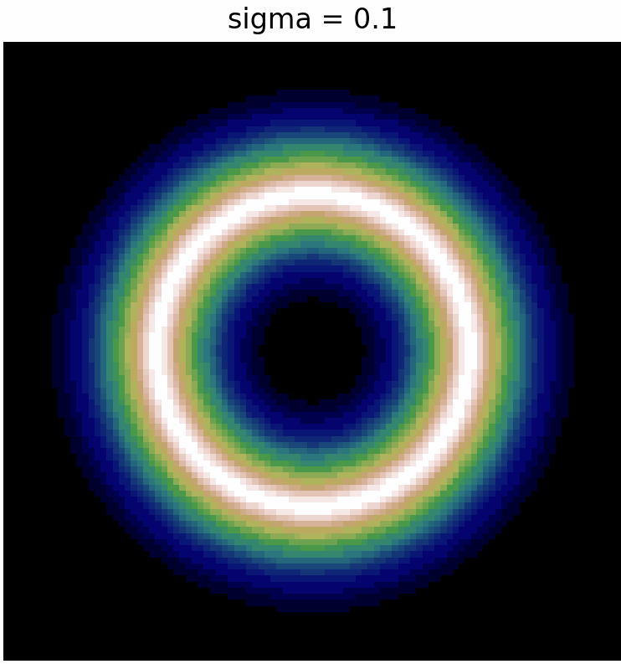
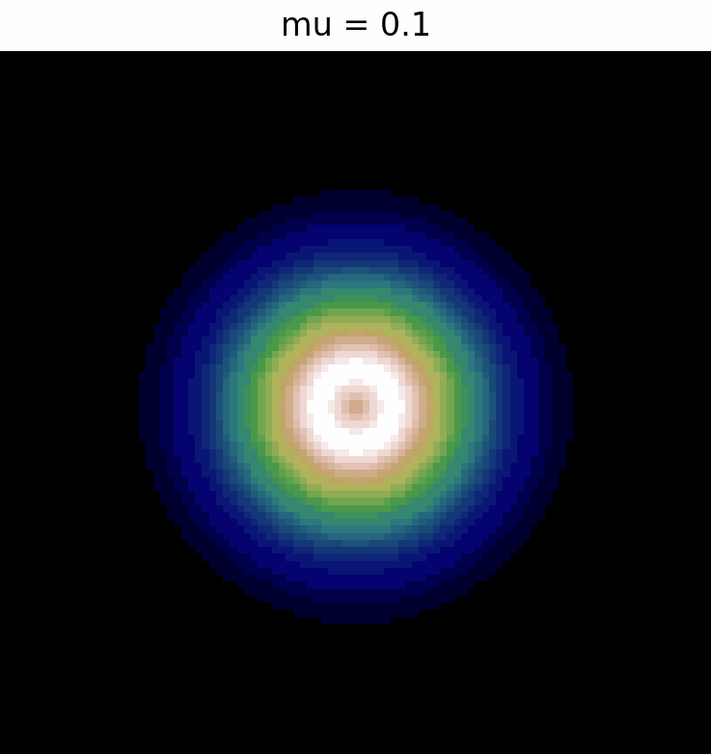
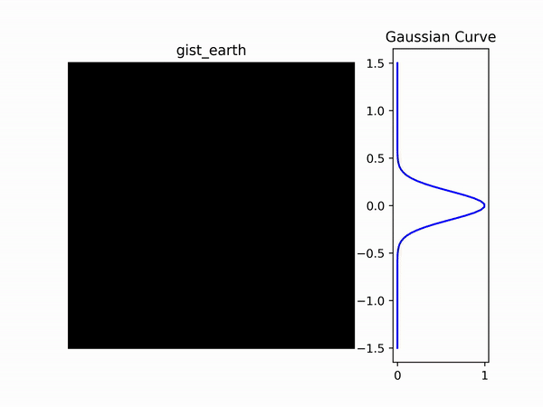
Lenia: Kernel Function
Smooth and blur
Influence of neighboring pixels
Weighted importance to neighboring pixels and gradually reduced importance to distant pixels.
Convolution operation
Input: distance, mu, sigma
Operation
  Find radius, initialize empty mesh grid of coordinates
  calculate the distances of each coordinate from the center and apply a mask to filter out values outside the desired radius
Output: Kernel array
Kernel with varying sigma
Kernel with varying mu
Mu = 0.5, sigma=0.15
How kernel is developed
Notes:
mu represents the mean or center of the Gaussian function. It determines the position of the peak of the Gaussian curve. In the context of the ring kernel, it affects the intensity or weight assigned to the central region of the kernel. A smaller value of mu will result in a narrower and more concentrated peak, while a larger value of mu will create a broader peak.
sigma represents the standard deviation of the Gaussian function. It controls the spread or width of the Gaussian curve. In the context of the ring kernel, it determines how quickly the intensity or weight decreases as we move away from the center. A smaller value of sigma will result in a sharper transition and a more pronounced ring structure, while a larger value of sigma will create a smoother transition and a more diffuse ring.
Lower values of mu and sigma will create sharper and more concentrated ring structures, while higher values will result in broader and smoother ring structures. These parameters allow you to control the size, intensity, and smoothness of the ring kernel to suit your specific needs or visual preferences.

Slide 11
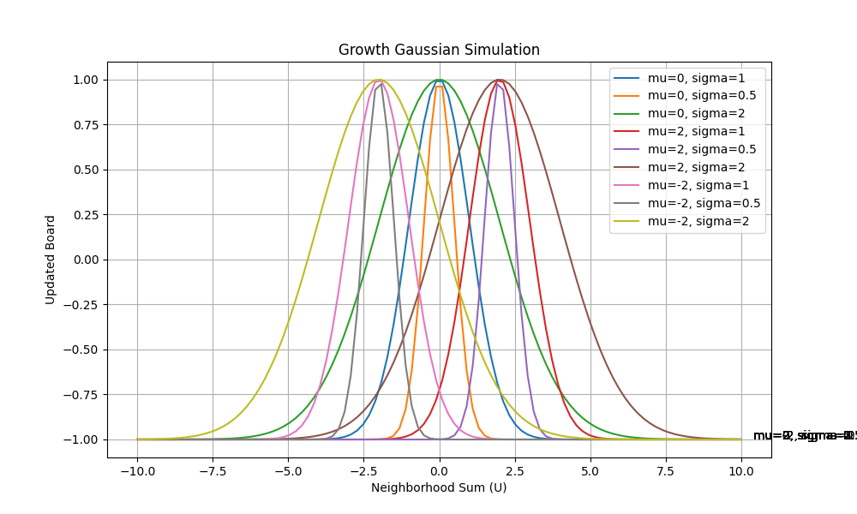
Lenia: Growth Function
Update board
It takes an input array representing the neighborhood sum and uses a Gaussian function to calculate the growth value for each element.
This function provides a smooth and continuous function that gradually changes the board state in a more fluid like manner.
By adjusting the mean and standard deviation parameters of the Gaussian function, each cell’s growth or decay can be precisely controlled allowing wide range of patterns.
Notes:
The growth function applies a smooth Gaussian growth function to update a board based on the neighborhood sum.
It takes an input array representing the neighborhood sum and uses a Gaussian function to calculate the growth value for each element.
The Gaussian growth function is then applied to the neighbourhood sum with two parameters: the mean or centre of the curve m and the standard deviation or spread of the curve. This function provides a smooth and continuous function that gradually changes the board state in a more fluid like manner. The smoothness of the Gaussian function prevents sudden and unrealistic patterns. By adjusting the mean and standard deviation parameters of the Gaussian function, each cell’s growth or decay can be precisely controlled. This allows for a wide range of patterns, from simple geometric shapes to complex and intricate structures in the Lenia simulation.

Slide 12
Part 2: Evo Lenia

Slide 13
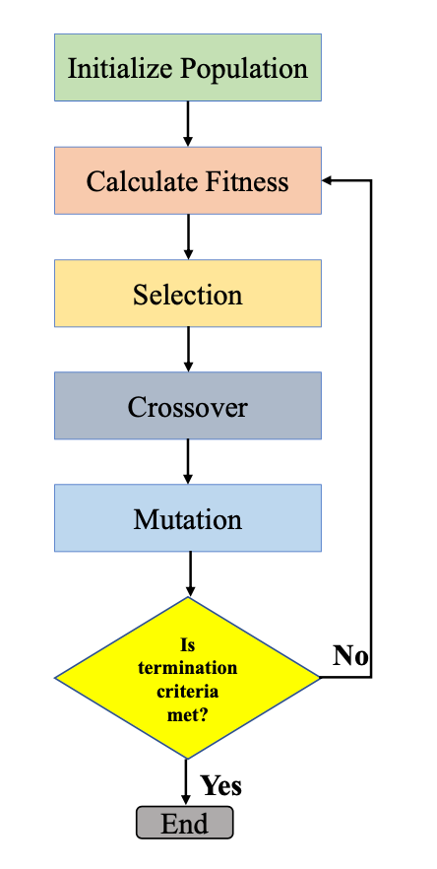
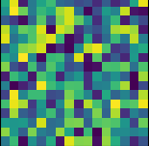
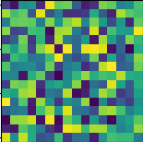
EvoLenia Genetic Algorithm
Random board,
Random Kernel

Slide 14
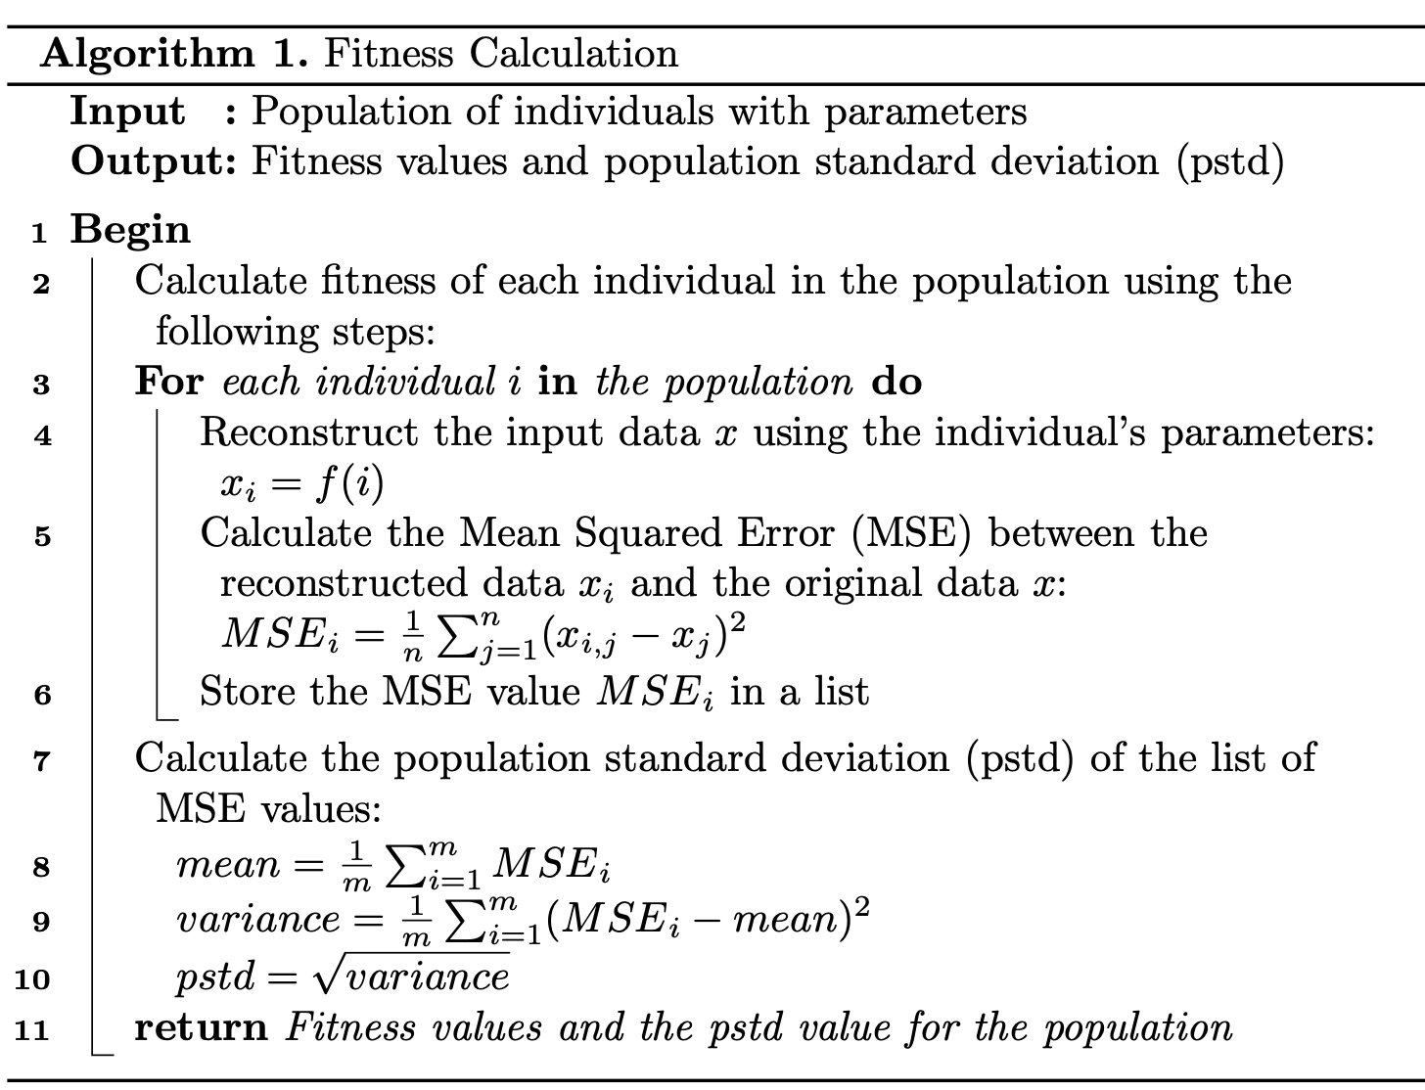
EvoLenia Genetic Algorithm : Fitness AE
AE

Slide 15
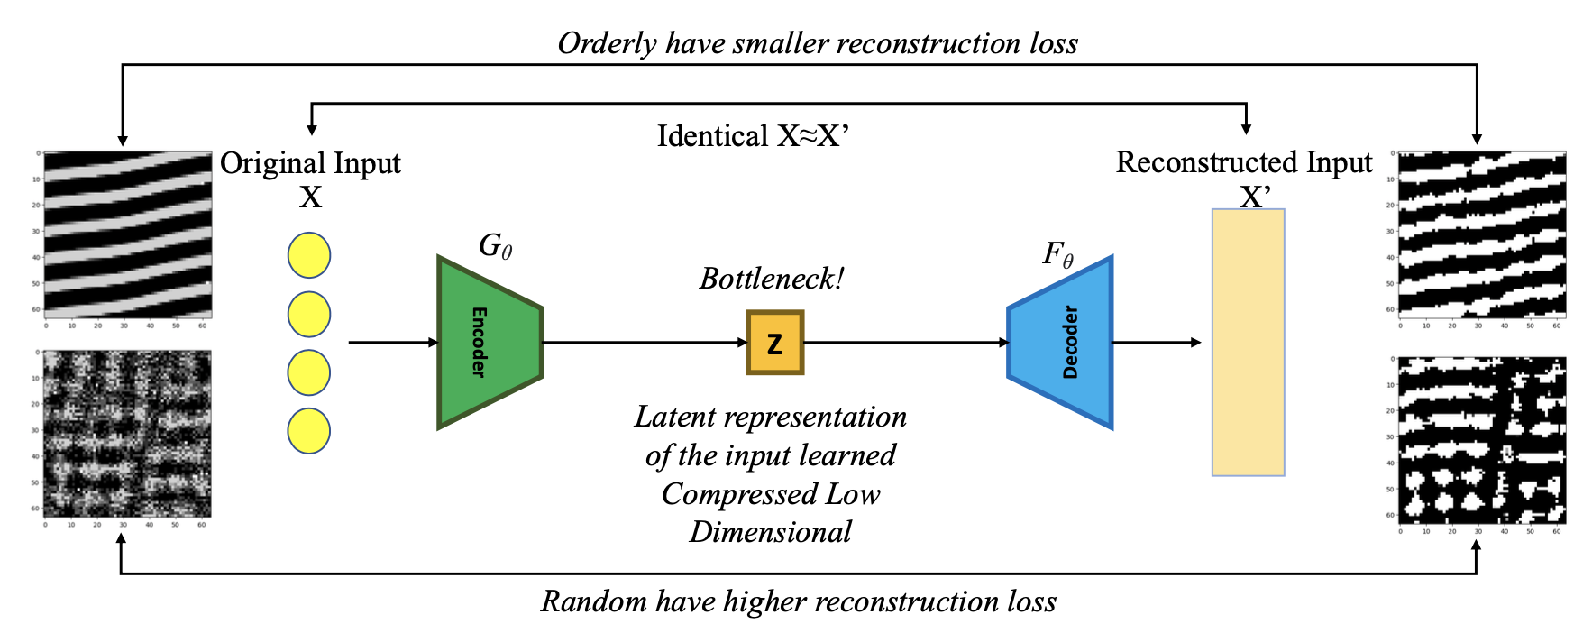
EvoLenia Genetic Algorithm : Fitness AE

Slide 16
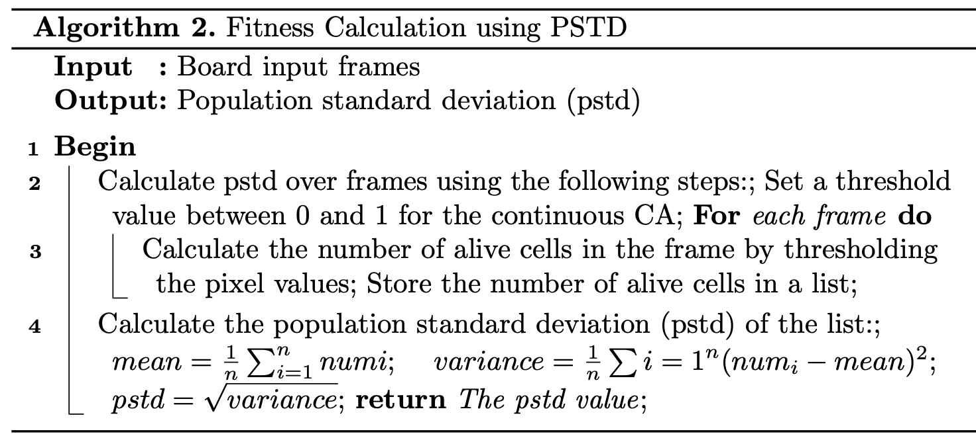
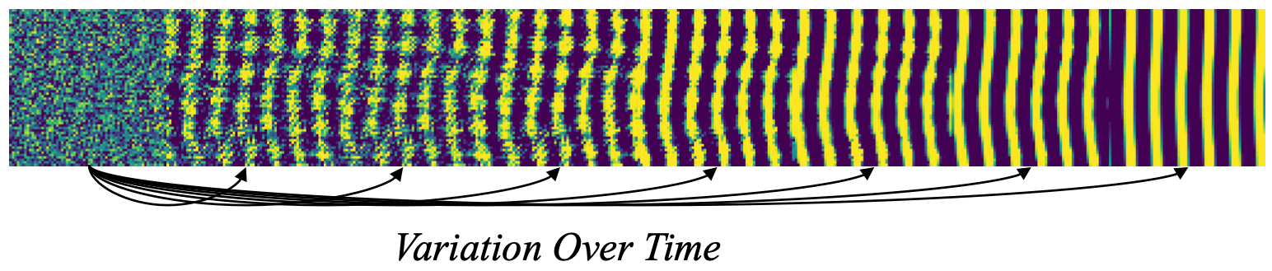
EvoLenia Genetic Algorithm : Fitness VoT
VoT

Slide 17
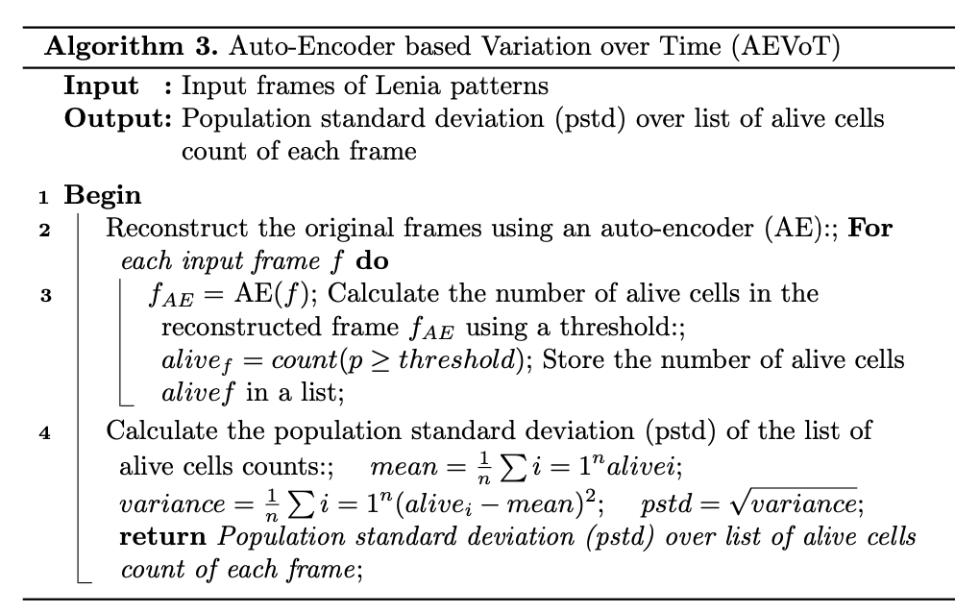
EvoLenia Genetic Algorithm: Fitness AEVoT
AEVoT

Slide 18
EvoLenia Genetic Algorithm: Selection
Roulette Wheel
Selection

Slide 19
EvoLenia Genetic Algorithm: Crossover
No Crossover!

Slide 20
EvoLenia Genetic Algorithm: Mutation
Mutation, by perturbation
➔ By assigning it a random float value between 0 and 1, rounded to 3 decimal places.

Slide 21
Results (AE)
No good fitness could be identified such that it could provide hint for improvement at longer generations

Slide 22
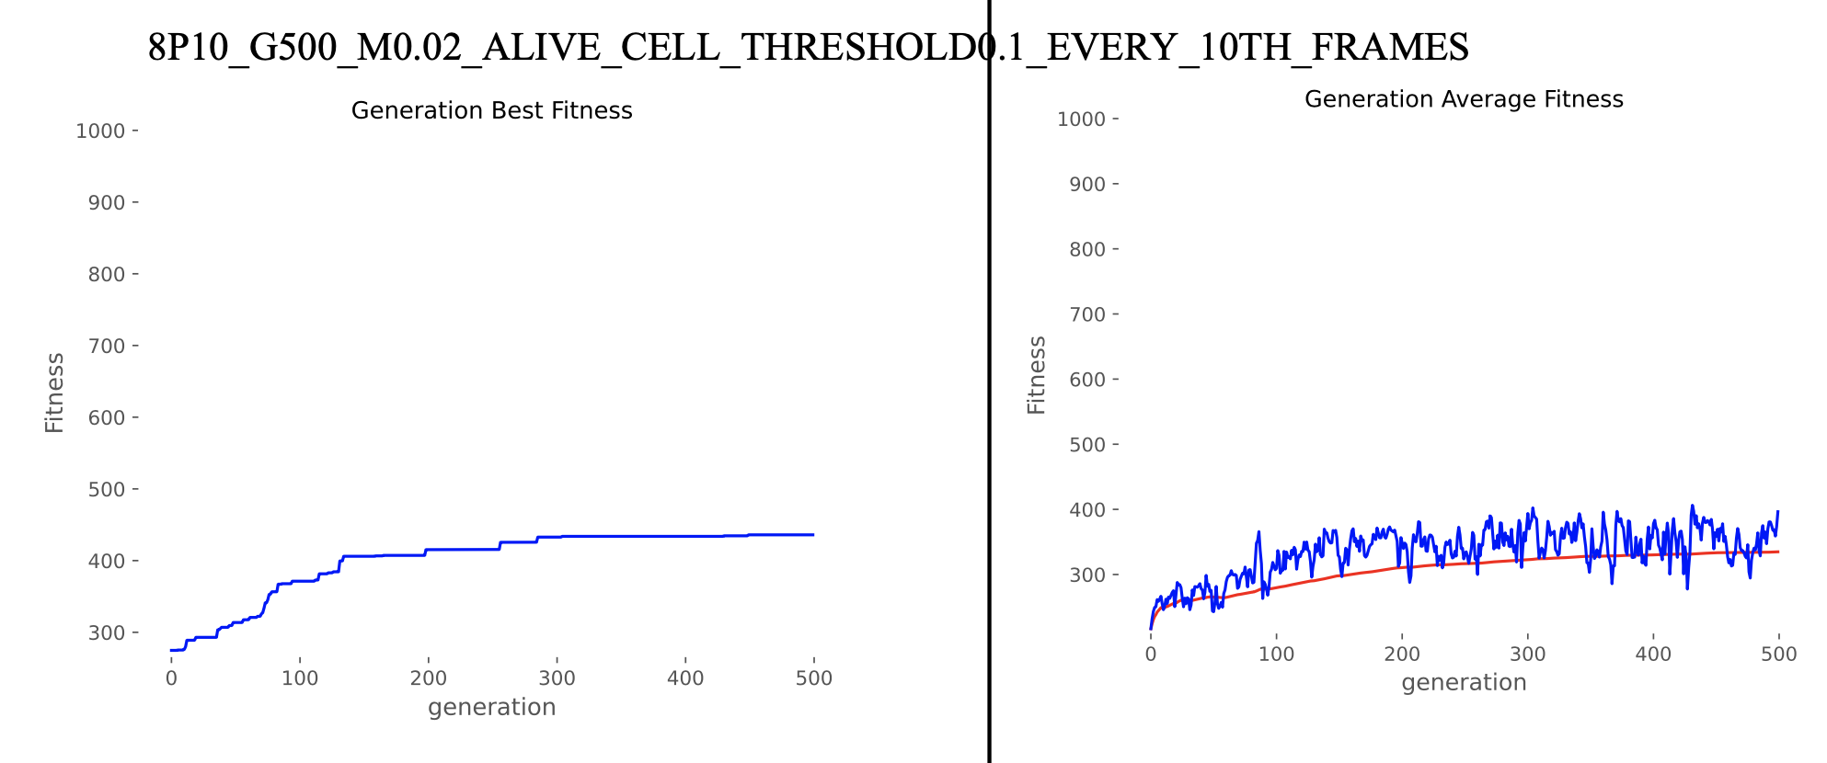
Results (VoT)
A plot could be identified that could hint scope of improvement when run for longer generations!

Slide 23
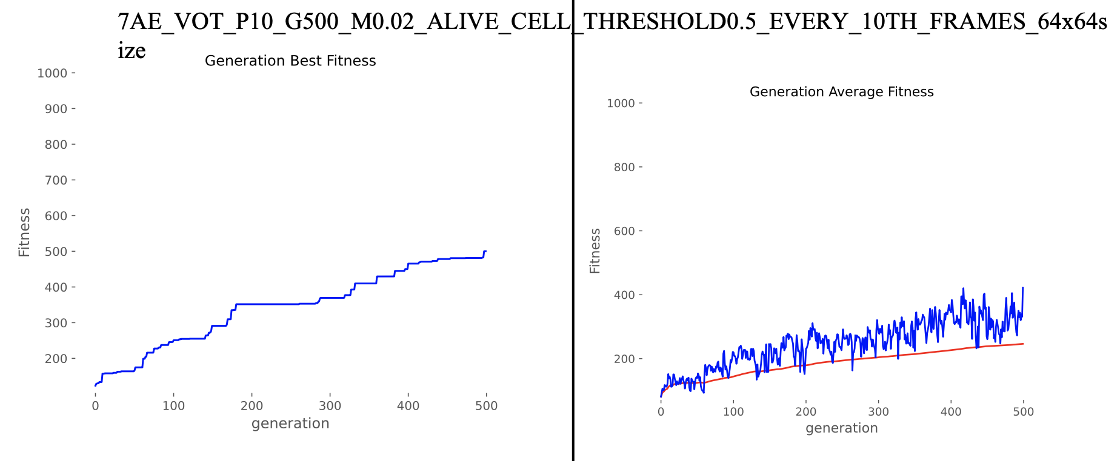
Results (AEVoT)
A plot could be identified that could hint scope of improvement when run for longer generations!

Slide 24
Results (2500 generations)

Slide 25
Results (Known Kernel Evolution)

Slide 26
Challenges, Learnings and Conclusion
Challenges (Project Related)
  Memory and Computation: EC requires time!
  Boon or Bane: Flexibility of Lenia parameters
  How to scale AutoEncoder fitness on same scale as VoT and AEVoT?
  Training a right size of bottleneck for AE fitness: How much information we can afford to lose?

Slide 27
Challenges, Learnings and Conclusion
Challenges (Concept based)
  Automated Discovery: Novelty Search, Quality Diversity, Interactive EC for Morphogenesis
  Emergent Agency: Neural CA, Sensorimotor Lenia, Train creatures by backprop, avoid obstacles, eat energy
  Swarm Cognition: Evolve collective behaviors & intelligence; Biological levels - organelles, cells, organisms, colonies/societies
  Open Endedness: Complexity, emergence of behavior, self-replication, movement etc.
  Turing Completeness: Can Lenia perform memory-based operations, logic gates etc.
🧬
Ref: Open Science Lenia, Bert Chan, Will Cavendish ALIFE 2021
https://openlenia.github.io/

Slide 28
Challenges, Learnings and Conclusion
Learnings
  Evolution is time taking!
  A strong hypothesis and supporting proofs, yields good results (We discovered a ring forming bacteria)
  LaTex report / arXiv
  Explore Lenia Space and Exploit Kernel
  Highly experimental
  Lenia, as a computational system, provides a platform for exploring emergent behaviors that mimic some of the properties of living systems, such as self-organization, pattern formation, and adaptation to changing environments.

Slide 29
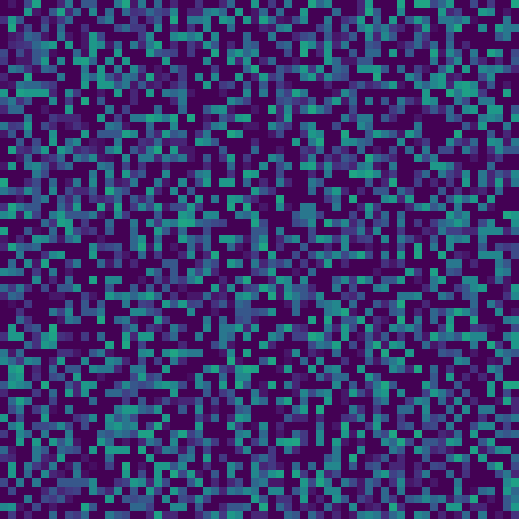
Challenges, Learnings and Conclusion
Conclusion
  Reproduced Standard Lenia
  Setup EC with three fitness: VoT, AE, and AEVoT
  We ran 27 standard known configuration experiments
  5 known kernel experiments
  2 long generation size experiments
  Five-fold validation
  Discovered a ring forming bacteria

Slide 30
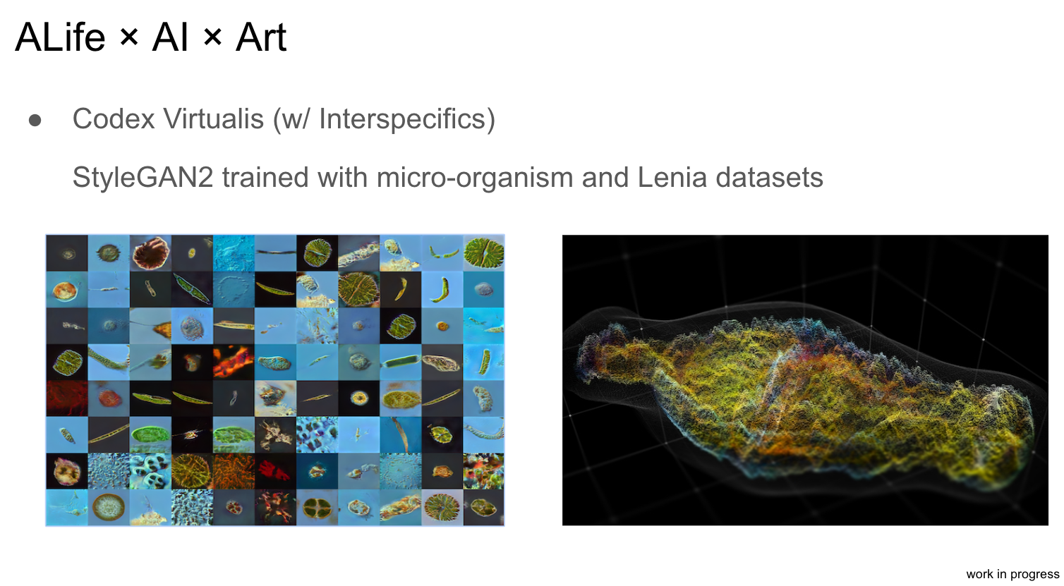
Future Scope of Improvement
Working with known kernels
Interactive EC
Not only mutating kernel, but also Growth Function!
Particle Lenia, studying LJ potential
Flow Lenia
Sensorimotor Lenia / Differentiable Lenia
Using JAX
Reference: ALife 2021

Slide 31
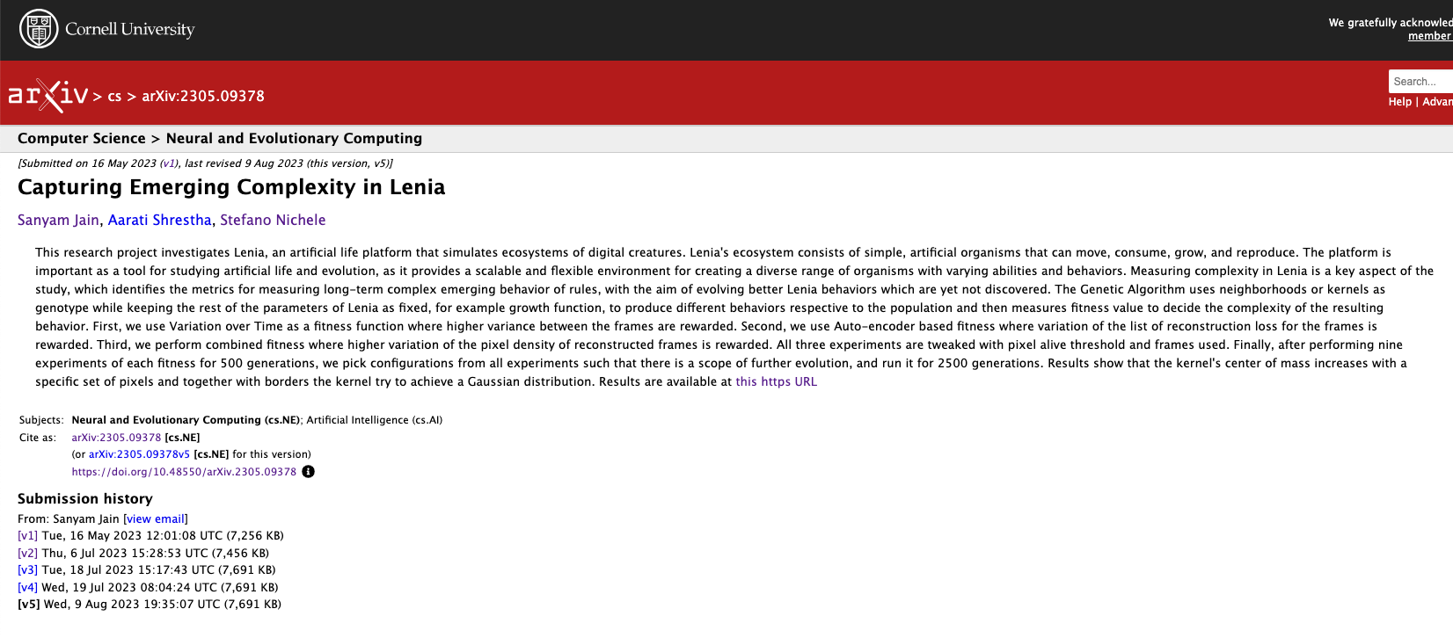
Preprint and Media
Preprint: https://arxiv.org/abs/2305.09378

Slide 32
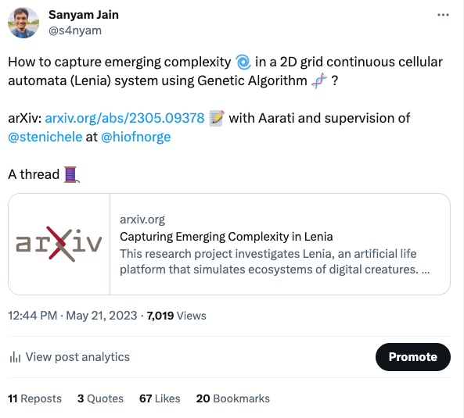
Preprint and Media
Recognition on Twitter https://twitter.com/s4nyam/status/1660235194157203458?s=61&t=y2rFAyDjvKnfRy_OdjGjGA

Slide 33
References
[1] K. O. Stanley, J. Lehman, and L. Soros, “Open-endedness: The last grand challenge you’ve never heard of,” While open-endedness could be a force for discovering intelligence, it could also be a component of AI itself, 2017.
[2] K. Gregor and F. Besse, “Self-organizing intelligent matter: A blueprint for an ai generating algorithm,” arXiv preprint arXiv:2101.07627, 2021.
[3] B. W.-C. Chan, “Lenia-biology of artificial life,” arXiv preprint arXiv:1812.05433, 2018.
[4] B. W.-C. Chan, “Lenia and expanded universe,” arXiv preprint arXiv:2005.03742, 2020.
[5] A.Variengien,S.Nichele,T.Glover,andS.Pontes-Filho,“Towards self-organized control: Using neural cellular automata to robustly control a
cart-pole agent,” arXiv preprint arXiv:2106.15240, 2021.
[6] G. Hamon, M. Etcheverry, B. W.-C. Chan, C. Moulin-Frier, and P.-Y. Oudeyer, “Learning sensorimotor agency in cellular automata,” 2022.
[7] E. Plantec, G. Hamon, M. Etcheverry, P.-Y. Oudeyer, C. Moulin-Frier, and B. W.-C. Chan, “Flow Lenia: Mass conservation for the study of virtual creatures in continuous cellular automata,” arXiv preprint arXiv:2212.07906, 2022.
[8] Alexander Mordvintsev, Eyvind Niklasson, Ettore Randazzo, Google December 23, 2022 Particle Lenia and the energy-based formulation (no date). Available at: https://google-research.github.io/self-organising- systems/particle-lenia/ (Accessed: March 6, 2023).
[9] D. Medernach, T. Kowaliw, C. Ryan, and R. Doursat, “Long-term evo- lutionary dynamics in heterogeneous cellular automata,” in Proceedings of the 15th annual conference on Genetic and evolutionary computation, 2013, pp. 231–238.
[10] H. Cisneros, J. Sivic, and T. Mikolov, “Evolving structures in complex systems,” in 2019 IEEE Symposium Series on Computational Intelli- gence (SSCI), 2019, pp. 230–237.
[11] H.Cisneros,J.Sivic,andT.Mikolov,“Visualizingcomputationinlarge- scale cellular automata,” arXiv preprint arXiv:2104.01008, 2021.
[12] Chan, B. W. C. (2023). Towards Large-Scale Simulations of Open-
Ended Evolution in Continuous Cellular Automata. arXiv preprint arXiv:2304.05639.
https://docs.google.com/presentation/d/1TXVtoPr9NCjZIB2PuAIn2ewCDCEn8R8z4M3JpP3Eg6I/edit#slide=id.ge2b2800b58_1_623
https://chakazul.github.io/lenia-CE/lenia.html
https://arxiv.org/pdf/2205.10463.pdf

Slide 34



Explore Yourself, scan this QR: s4nyam.github.io/evolenia

